Slide 1

Cybersecurity Compliance and Reporting Platform
2025 July
YIP Wankit, Daniel 3036383678
CHAN Cheung Hei 3036381280
SONG Insu 3036199596
WONG Kwun Yuet Shavonne 2013534309
YEUNG Hiu Ying 3036379976
1
Notes:
Good morning examiners. Our topic is Cybersecurity compliance and reporting platform.
I am anni,
This is Insu, Daniel, Anthony and Shavonne

Slide 2

AGENDA
Project Overview
Methodology
Performance Evaluation
Demonstration
Conclusion
Notes:
We have 5 agendas today

Slide 3
Project Overview
3

Slide 4



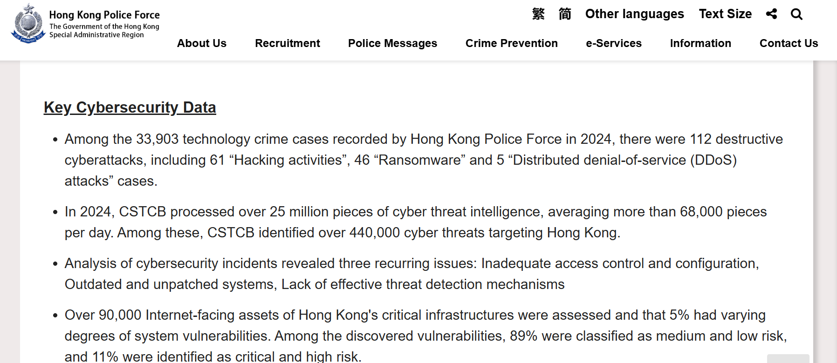
Cyber threats and technology crimes are rapidly increasing in Hong Kong, with more frequent and severe attacks
The Standard | In 2023, cyber security incidents increased by 39% and technology crimes rose by 50%. Data breach notifications, especially those caused by hacking, also more than doubled. [1]
Mayer Brown | Cybersecurity incidents recorded a 65.2% quarter-to-quarter increase in 2024 Q1 [2]
Check Point | Threat Intelligence Report: An organization in Hong Kong is being attacked on average 1675 times per week in the last 6 months in 2025 [4]
HK Police Force | In 2024, Hong Kong recorded over 33,900 technology crimes, including 112 serious cyberattacks [3]
[1] https://www.thestandard.com.hk/breaking-news/article/221493/Cyber-threats-in-Hong-Kong-on-the-rise [2] https://www.mayerbrown.com/en/insights/publications/2024/10/cyber-threats-on-the-rise-dissecting-the-common-themes-behind-recent-cybersecurity-incidents-in-hong-kong [3] https://www.police.gov.hk/ppp_en/04_crime_matters/tcd/cybersecurityreport2024.html [4] https://blog.checkpoint.com/executive-insights/beyond-defense-hong-kongs-new-era-of-financial-cyber-resilience/#
4
Notes:
To begin, let’s have an overview on current cyber risk landscape in Hong Kong. We can look at some statistics. In recent years, Hong Kong has experienced a sharp rise in cyber incidents with significant data breaches.
In average, organizations now face more than 1,600 attacks per week. This highlights the urgent need for stronger defense capability and effective incident reporting.
https://blog.checkpoint.com/executive-insights/beyond-defense-hong-kongs-new-era-of-financial-cyber-resilience/#
https://www.aon.com/apac/insights/blog/default/cyber-risk-mitigation-what-is-changing-under-new-l
https://www.mayerbrown.com/en/insights/publications/2024/10/cyber-threats-on-the-rise-dissecting-the-common-themes-behind-recent-cybersecurity-incidents-in-hong-kong
https://www.police.gov.hk/ppp_en/04_crime_matters/tcd/cybersecurityreport2024.html
https://www.thestandard.com.hk/breaking-news/article/221493/Cyber-threats-in-Hong-Kong-on-the-rise

Slide 5

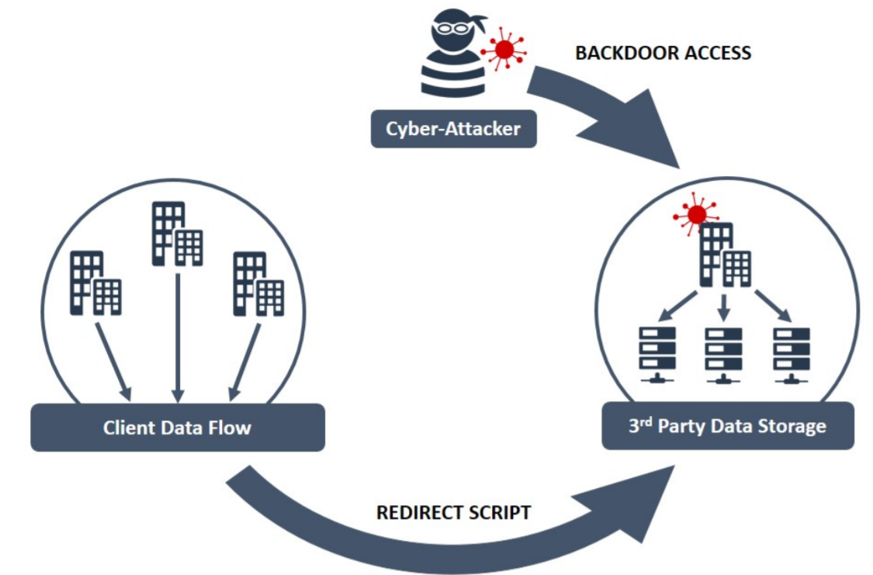
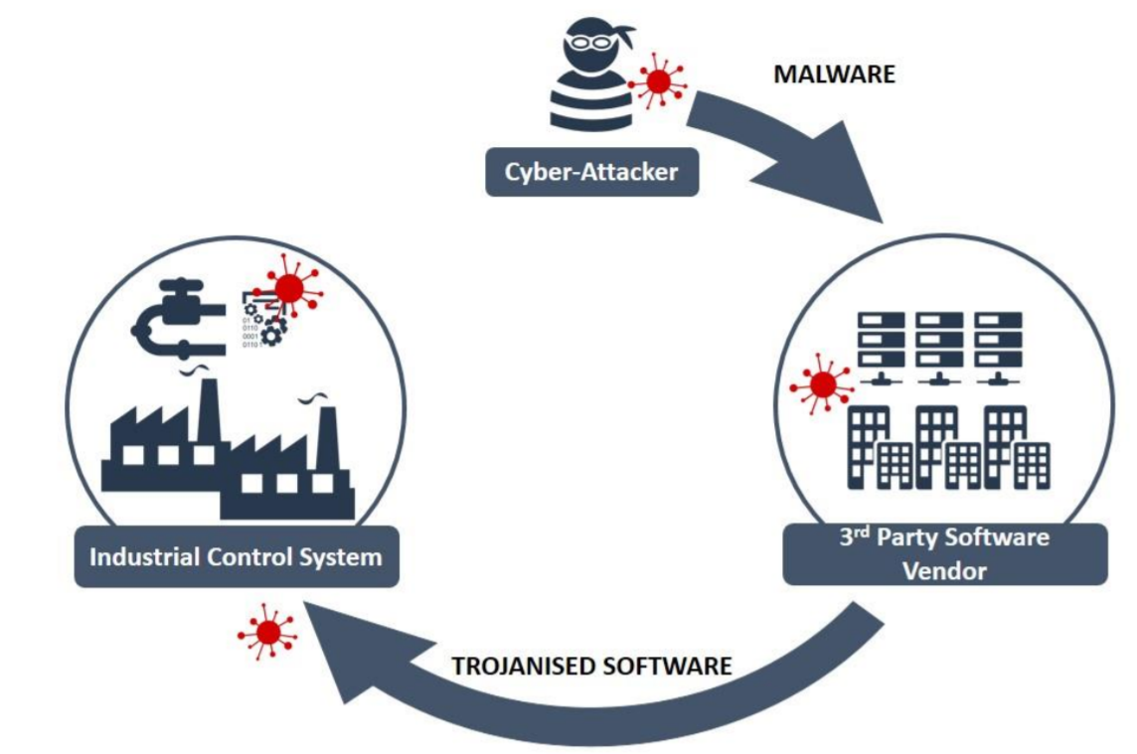
Strengthen statutory requirements and Higher regulatory expectation
Weaker link
/ Non-critical sectors
Critical sectors
The Bill is set to take effect on 1 January 2026. [1]
Improve incident reporting
Ensure that organizations running vital services take strong measures to protect against evolving cyber threats
Safeguard Hong Kong’s economy, daily life, and reputation as an international business hub
[2]
5
[1] https://www.legco.gov.hk/yr2024/english/bills/b202412061.pdf [2] https://www.ncsc.gov.uk/collection/supply-chain-security/third-party-software-providers
Notes:
In response to the growing challenges, New legislation is being introduced to enhance the existing regulatory framework.
The Bill requires critical sectors to report serious cyber incidents within defined timeframes and implement enhanced cybersecurity controls.
While the law focuses on critical sectors, all organizations face the same threats. Non-critical sectors may be more easily exploited by attackers as entry points to critical sectors.
Considering supply chain attacks and third-party risks, enhancing cybersecurity across every organization is essential to protect the whole ecosystem.
https://www.legco.gov.hk/yr2024/english/bills/b202412061.pdf
https://www.ncsc.gov.uk/collection/supply-chain-security/third-party-software-providers
The accelerated pace of digital transformation has contributed to a significant rise in cyber incidents, as organizations increasingly adopt digital technologies. In Hong Kong, cyber threats and technology-related crimes are escalating in both frequency and severity. At the same time, strengthened statutory requirements and heightened regulatory expectations are making robust cybersecurity measures and effective incident reporting more critical than ever.

Slide 6







Timely and effective cybersecurity incident reporting
The accelerated pace of digital transformation
Importance
Strengthens both individual organizations and whole ecosystem
Improves information-sharing and reduces the spread of cyber threats
Key tool for regulators in coordinating sector-wide responses and improving cybersecurity policy
Significant rise in cyber incidents with escalation in both frequency and severity
Barriers
Our ideas
Unclear requirements: Different Regulators define key terms such as “significant” differently
Clear guidelines step by step via the centralized platform
strengthened statutory requirements & heightened regulatory expectations
Uncertainty of reportable events: time consuming as the threshold and criteria are vague and lack clear benchmarks
Provide AI-driven cyber incident criticality suggestions and regulatory reporting recommendations
Robust cybersecurity measures & effective incident reporting more critical
Poor data quality and human error make it difficult to reference previous cases, leading to inconsistent handling
AI-powered functions assist in completing incident details and provide advice on appropriate mitigation actions
6
Notes:
With these new requirements, organizations are expected to ensure timely and effective incident reporting.
However, many of them face delays in reporting due to unclear requirements. Different Regulators define key terms such as “material” and “significant” differently, while internal policies add further complexity.
As a result, it is often time consuming to determine whether an incident meets the threshold, since the criteria are vague and lack clear benchmarks.
In addition, even when incident reporting systems are in place, issues such as poor data quality and human error make it difficult to reference previous cases, leading to inconsistent handling.
Our solution is to provide a centralized platform that enables organisations to meet regulatory expectations and manage incidents more efficiently.
I will pass to Insu for the solution details

Slide 7
Methodology I
: Core Components
7

Slide 8
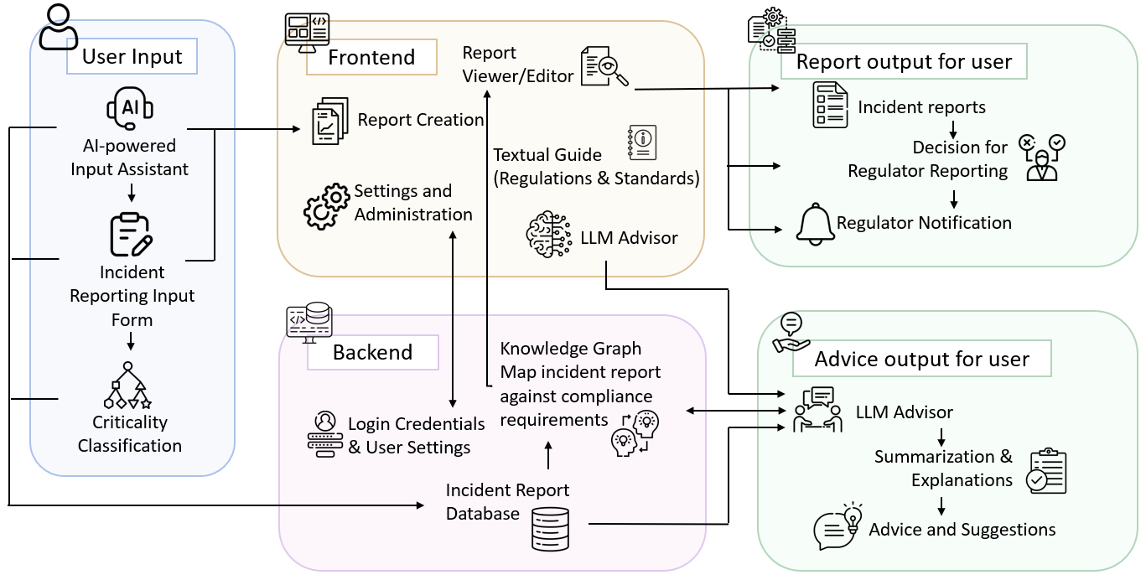
Methodology behind Cybersecurity Compliance and Reporting Platform
Built on 5 modular components for streamlined incident handling.
Combines rule-based logic (transparency) + LLM/AI (unstructured data processing).
Aligns with HK regulatory standards (e.g., OGCIO guides, PCPD templates).
8
Notes:
I will introduce the methodology behind our Cybersecurity Compliance and Reporting Platform.
As shown in this diagram, our platform is built on five connected core components: User Input, Frontend, Backend, Report, and Advice. This modular design ensures a seamless, end-to-end process for handling cybersecurity incidents—from data entry to actionable outcomes.
What makes our approach unique is the combination of rule-based logic and cutting-edge AI. The rule-based system delivers transparency and consistency, while Large Language Models (LLMs) handles unstructured data efficiently. Most importantly, our methodology aligns with Hong Kong’s regulatory standards, such as the OGCIO guides and PCPD templates, positioning it as a trusted solution for compliance in the region.

Slide 9



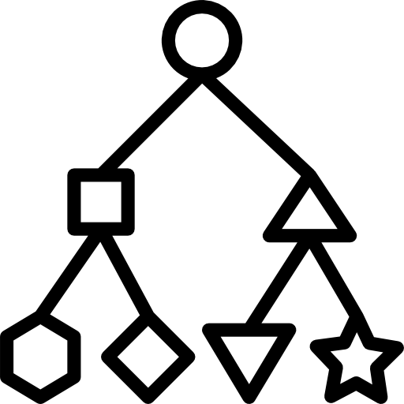
Methodology behind Cybersecurity Compliance and Reporting Platform
Key Tech: DeepSeek-R1 + LangChain + ChromaDB for Input Assistant.
Key Tech: XGBoost + Feature Engineering with rule-based model for Criticality Classifier
User Benefit: Reduces manual work; guides non-experts.
User Input
AI-powered Input Assistant
Incident Reporting Input Form
Criticality
Classifier
9
Notes:
Let’s look into the five core components more in details that power our platform
First, User Input. This component features an online form paired with an AI Assistant powered by DeepSeek-R1. Using LangChain and ChromaDB, it processes documents and auto-fills input entries, easing manual effort. For users, especially non-experts, this means faster, guided reporting without the guesswork.
Secondly, criticality classification model can effectively reduces users’ efforts to expect the criticality of their incident. For criticality classification, a machine learning model XGBoost is utilized. During its training process, a feature engineering technique is utilized using a rule-based logic to improve the performance.

Slide 10






Methodology behind Cybersecurity Compliance and Reporting Platform
Key Tech: React JS + Node.js for responsive UI.
User Benefit: Intuitive navigation; role-based views (user/regulator).
Frontend
Report Creation
Report Viewer/Editor
Textual Guide
(General Information)
Settings and Administration
LLM Advisor
10
Notes:
Next, the Frontend. Built with React JS and Node.js, our responsive user dashboard offers report creation, regulatory guides through both textual and LLM advisor, and settings in one intuitive interface. For providing a correct guides, our group reviewed existing regulations and compliaWith role-based views, it caters to both users and regulators, ensuring navigation is smooth and tailored to their needs.

Slide 11




Methodology behind Cybersecurity Compliance and Reporting Platform
Key Tech: Django (Python) + SQLite; ORM for DB management.
User Benefit: Cross-platform access; built-in security (XSS/CSRF protection).
Backend
Knowledge Graph
Map incident report against compliance requirements
Login Credentials
+ User Settings
Incident Report Database
11
Notes:
Now, the Backend. This is the backbone of our platform, managing data storage, security, and logic processing. We’ve leveraged Django, a Python framework, with SQLite and an Objective-relational mapper, ORM, for efficient database handling. Users enjoy cross-platform access and robust security features, like protection against XSS and CSRF (cross-site request forgery) attacks.

Slide 12




Methodology behind Cybersecurity Compliance and Reporting Platform
Key Tech: Rule-based engine.
User Benefit: Automated regulator mapping; avoids missed deadlines.
Report output for user
Incident reports
Decision for Regulator Reporting
Regulator Notification
12
Notes:
The Report component is where compliance comes to life. A rule-based engine maps incidents to the right regulators using a detailed logic framework. This automation eliminates missed deadlines and ensures reports meet regulatory standards effortlessly.

Slide 13
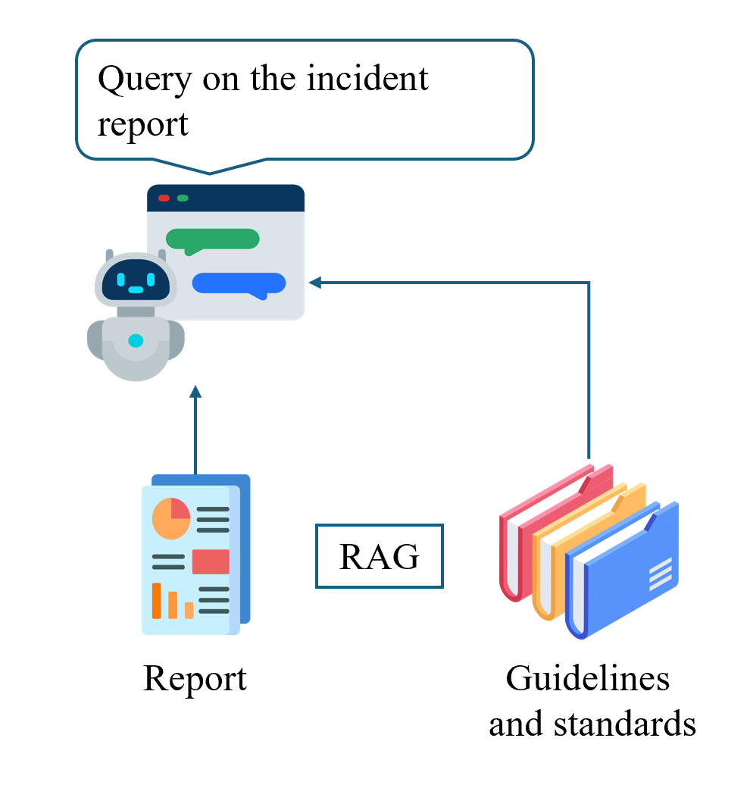




Methodology behind Cybersecurity Compliance and Reporting Platform
Key Tech: DeepSeek-R1 + LangChain + ChromaDB + NeMo guardrails for advice generation
User Benefit: Context-aware advice; prevents hallucinations.
Advice output for user
LLM Advisor
Summarization & Explanations
Advice and
Suggestions
13
Notes:
Finally, Advice. Powered by DeepSeek-R1 and NeMo guardrails, this component delivers LLM-driven insights—like mitigation steps and compliance tips. It’s context-aware and reliable, avoiding the pitfalls of AI hallucinations making use of RAG mechanism based on mapping of relevant guidelines and standards with extracted context from the user-provided incident report.

Slide 14
Methodology behind Cybersecurity Compliance and Reporting Platform
Inputs
Consultant Reports
Incident Descriptions
Form Data
Output 2
Incident Report
Output 3
Report Filtered by Regulator
Output 4
Summary of Incident
Output 1
Incident Criticality
Output 5
Advice on Mitigation and Prevention
14
Notes:
Finally, Advice. Powered by DeepSeek-R1 and NeMo guardrails, this component delivers LLM-driven insights—like mitigation steps and compliance tips. It’s context-aware and reliable, avoiding the pitfalls of AI hallucinations making use of RAG mechanism based on mapping of relevant guidelines and standards with extracted context from the user-provided incident report.

Slide 15
Methodology II
AI Model Performance Comparison and Selection
15

Slide 16

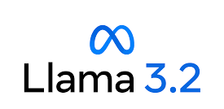




LLM-RAG-based Model Selection
We conducted experiments to select the most appropriate models for the three AI functionalities.
A. LLM-RAG-based Functions (Input Assistant and LLM Advisor)
Step 1: Build Standalone LLM-RAG Pipeline
Step 2: Implement Different LLMs and Perform Experiments
Upload PDF document
Extract text from uploaded pdf
Generate context vector embedding
(candidate models)
Store embedding in vector store
1. Context Vector Embedding Construction
Evaluate 4 popular candidate LLMs:
Open source: facilitate local deployment to ensure confidentiality of the submitted information.
Small model (2B~10B parameters): capable of running on development machine with RTX 4000 GPU [1].
DeepSeek R1, 1.5B
Llama 3.2, 3B
Retrieve embedding & load local LLM (candidate models)
Provide context and info type specific queries (text, number, date, Boolean and multiple choice)
If type is multiple choice, load choices and rules
Store the LLM responses in a
CSV file
DeepSeek R1, 8B
Mistral, 7B
2. Generate Responses to Queries
Clean the LLM responses
Conduct performance comparison
Select model that is the most appropriate
3. Clean the Responses & Perform Analysis
[1] https://www.databasemart.com/blog/choosing-the-right-gpu-for-popluar-llms-on-ollama
16
Notes:
In this part, I will discuss the work we did to select the most appropriate models for the 3 AI functionalities on this platform.
The selection was carried out by building a standalone pipeline and conducting experiments using different models.
For the LLM-RAG-based functions like the Input Assistant and Advisor, we evaluated four open-source LLMs: DeepSeek R1 (1.5 and 8B), Llama 3.2 (3B), and Mistral (7B). These models were selected for their suitability for local deployment and compatibility with the development machine.

Slide 17
LLM-RAG-based Functions (Input Assistant and LLM Advisor)
Performance Metric | Evaluation Method
Processing Time | LLM-RAGs were provided 100 pdf reports derived from real-world incidents [1][2] and evaluated using 700 data extraction queries, with 7 queries per report.
Extraction Accuracy
Generation Relevancy | LLM-RAGs were provided a guidance document and evaluated using 100 guidance enquiry queries and comparing the responses to expected responses generated with a large LLM (Grok 3, 2.7T parameters) and verified by human. The responses were converted into embeddings using a sentence transformer (all-MiniLM-L6-v2) [3] and compared using cosine similarity [4].
$$Average Processing Time= \frac{Total processing time}{Total number of queries}$$
$$Average Extraction Accuracy= \frac{Number of extracted instances agreeing with human judgement }{Total number of queries}$$
$$Average Generation Relevancy= \frac{\sum_{k=1}^{n}{cosine_similarity\left({gen_embedding}_{k}, {exp_embedding}_{k}\right)}}{Total number of queries}$$
$$cosine_similarity \left(u, v\right)= \frac{u⋅v}{\left\|u\right\| \left\|v\right\|}$$
[1] https://www.pcpd.org.hk/english/enforcement_reports/report.html, [2] https://eurepoc.eu/database/
[3] https://sbert.net/, [4] https://www.mdpi.com/2504-2289/9/3/67
gen_embedding, exp_embedding are generated and expected response embeddings from query k
u, v are arbitrary vector embeddings
17
Notes:
We evaluated the LLM-based functions using three metrics. We used to metrics to evaluate the performance.
To assess processing time and extraction accuracy, we used 700 data extraction queries from 100 pdf reports.
For the generation relevancy, we supplied a guidance document to the LLM-RAGs and inputted 100 guidance enquiry queries. We compared their responses to the expected answers by converting them into embeddings with a sentence transformer and calculating the cosine similarity.
The formula for calculating the performance metrics are shown in this slide. We will explain the meaning of these metrics and their desired outcomes in the following slides.

Slide 18
Processing Time
Measures how fast LLM-RAG responds to a query. Less processing time is desired for better user experience.
Chain of thought (COT) [1]
reasoning increases processing time
16.21 secs per query is acceptable compared to official DeepSeek API’s average time of 30.99 secs [2]
Best Model
[1] https://arxiv.org/html/2501.12948v1. [2] https://lowryonleadership.com/2025/01/27/testing-deepseek-v3-how-to-choose-an-ai-api/
18
Notes:
Processing time measures the LLM-RAG's response speed, with less time desired.
The results show that Llama 3.2, 3B is the fastest model, while DeepSeek is considerably slower due to its chain-of-thought reasoning.
Although DeepSeek has longer processing time, it performs well compared to its official API, which averages 30.99 seconds.

Slide 19
Extraction Accuracy
Evaluates the LLM-RAG’s information extraction capability. Higher accuracy is desired for reliable extraction.
Best Model
COT increases extraction accuracy
0.90 is good and comparable with commercial model
GPT-4o Mini’s 0.93 average accuracy [1]
[1] https://techcommunity.microsoft.com/blog/azureforisvandstartupstechnicalblog/evaluating-the-quality-of-ai-document-data-extraction-with-small-and-large-langu/4157719/
19
Notes:
Extraction accuracy assesses the LLM-RAG's data extraction capability, with higher accuracy preferred.
As expected, DeepSeek R1, 8B performs best due to greater number of parameters and chain-of-thought implementation.
Its accuracy is comparable to smaller commercial LLMs like GPT-4o Mini.

Slide 20
Generation Relevancy
Assesses the relevance of the LLM-RAG generated information to the guidance document. Higher relevance is desired for coherent response.
Best Model
0.83 is good and comparable to the 0.85 average relevancy score in [1], which used MiniLM-L6 for journal recommendations
[1] https://www.mdpi.com/2504-2289/9/3/67
20
Notes:
Generation relevancy measures how closely the LLM-RAG's response aligns with the guidance document, with higher relevance preferred.
DeepSeek R1, 8B performs the best in this area.
Its performance is comparable to a reference study that used the same sentence transformer for journal recommendations.

Slide 21
Performance Comparison
To select the most appropriate model we assigned scores to each evaluated performance metric.
(1st = 5 pts, 2nd = 3 pts, 3rd = 1 pts, 4th = 0 pts)
(more points are given to first place to emphasize excellence in a particular metric)
 | Processing Time | Extraction Accuracy | Generation Relevancy | Total Score
Deepseek R1, 1.5B | 1 | 1 | 0 | 2
Llama 3.2, 3B | 5 | 0 | 1 | 6
Mistral, 7B | 3 | 3 | 3 | 9
Deepseek R1, 8B | 0 | 5 | 5 | 10
Deepseek R1, 8B was chosen for its relatively better extraction accuracy and generation relevancy.
21
Notes:
We assigned scores to each evaluated model and selected DeepSeek R1, 8B for its relatively better extraction accuracy and generation relevancy performance.

Slide 22





ML-based Model Selection
B. ML-based Function (Criticality Classifier)
Step 1: Build ML Model Training Pipeline
Raw Dataset
Data Cleansing
& Preprocessing
Feature Engineering
Model Training
Testing and Evaluation
Step 2: Implement Different ML Models and Perform Experiments
Evaluate 6 popular candidate ML models:
Logistic Regression, SVM, KNN, Gradient Boosting, Random Forest, and XGBoost.
The candidate models cover a wide range of types — from simple models to complex ensemble methods. This increases the likelihood of finding a well-suited model.
Due to limited annotated data and the straightforward nature of the task,
we didn’t consider Neural Networks.
22
Notes:
For the criticality classifier, which is a ML-based function, we assessed six popular ML models: Logistic Regression, SVM, KNN, Gradient Boosting, Random Forest, and XGBoost. This candidate model list covers a wide range of types — from simple models to complex ensemble methods. Given the limited annotated data and task simplicity, we opted not to include Neural Networks.

Slide 23
ML-based Function (Criticality Classifier)
Best Model
Performance Metric
Performed evaluation using precision, recall, and F1-score, which are standard metrics for classification models [1].
Evaluation Method
EuRepoC Global Dataset [2]:compromised of 3,416 annotated global cyber incidents.
Data Cleansing and Preprocessing: removed incomplete data and applied ordinal encoding, resulting in 1,984 records.
Feature Engineering: used Nvidia Nemotron to generate scores for Financial Impact, Operational Impact, Data Leakage Impact, and the Number of Affected Individuals by providing predefined rules.
Model Training: trained machine learning models using engineered features to classify the criticality.
Chosen Model: XGBoost
23
[1] https://developers.google.com/machine-learning/crash-course/classification/accuracy-precision-recall,
[2] https://eurepoc.eu/database/
Notes:
We used three metrics, precision, recall and F1 score to select the most appropriate model for the criticality classifier. To evaluate the performance
The evaluation used the EuRepoC Global Dataset that compromises of 3,416 annotated global cyber incidents.
Which was cleansed and pre-processed, resulting in 1,984 usable records. annotated global cyber incidents.
Then we performed feature engineering using Nvidia Nemotron to generate scores for Financial Impact, Operational Impact, Data Leakage Impact, and the Number of Affected Individuals by providing predefined rules. Using the engineered features,
Finally, we trained machine learning models using the engineered features to classify the overall criticality.
Based on the results, we chose XGBoost.

Slide 24
Demonstration
24
Notes:
I'll hand it over to Anthony, who will provide the demonstration.

Slide 25
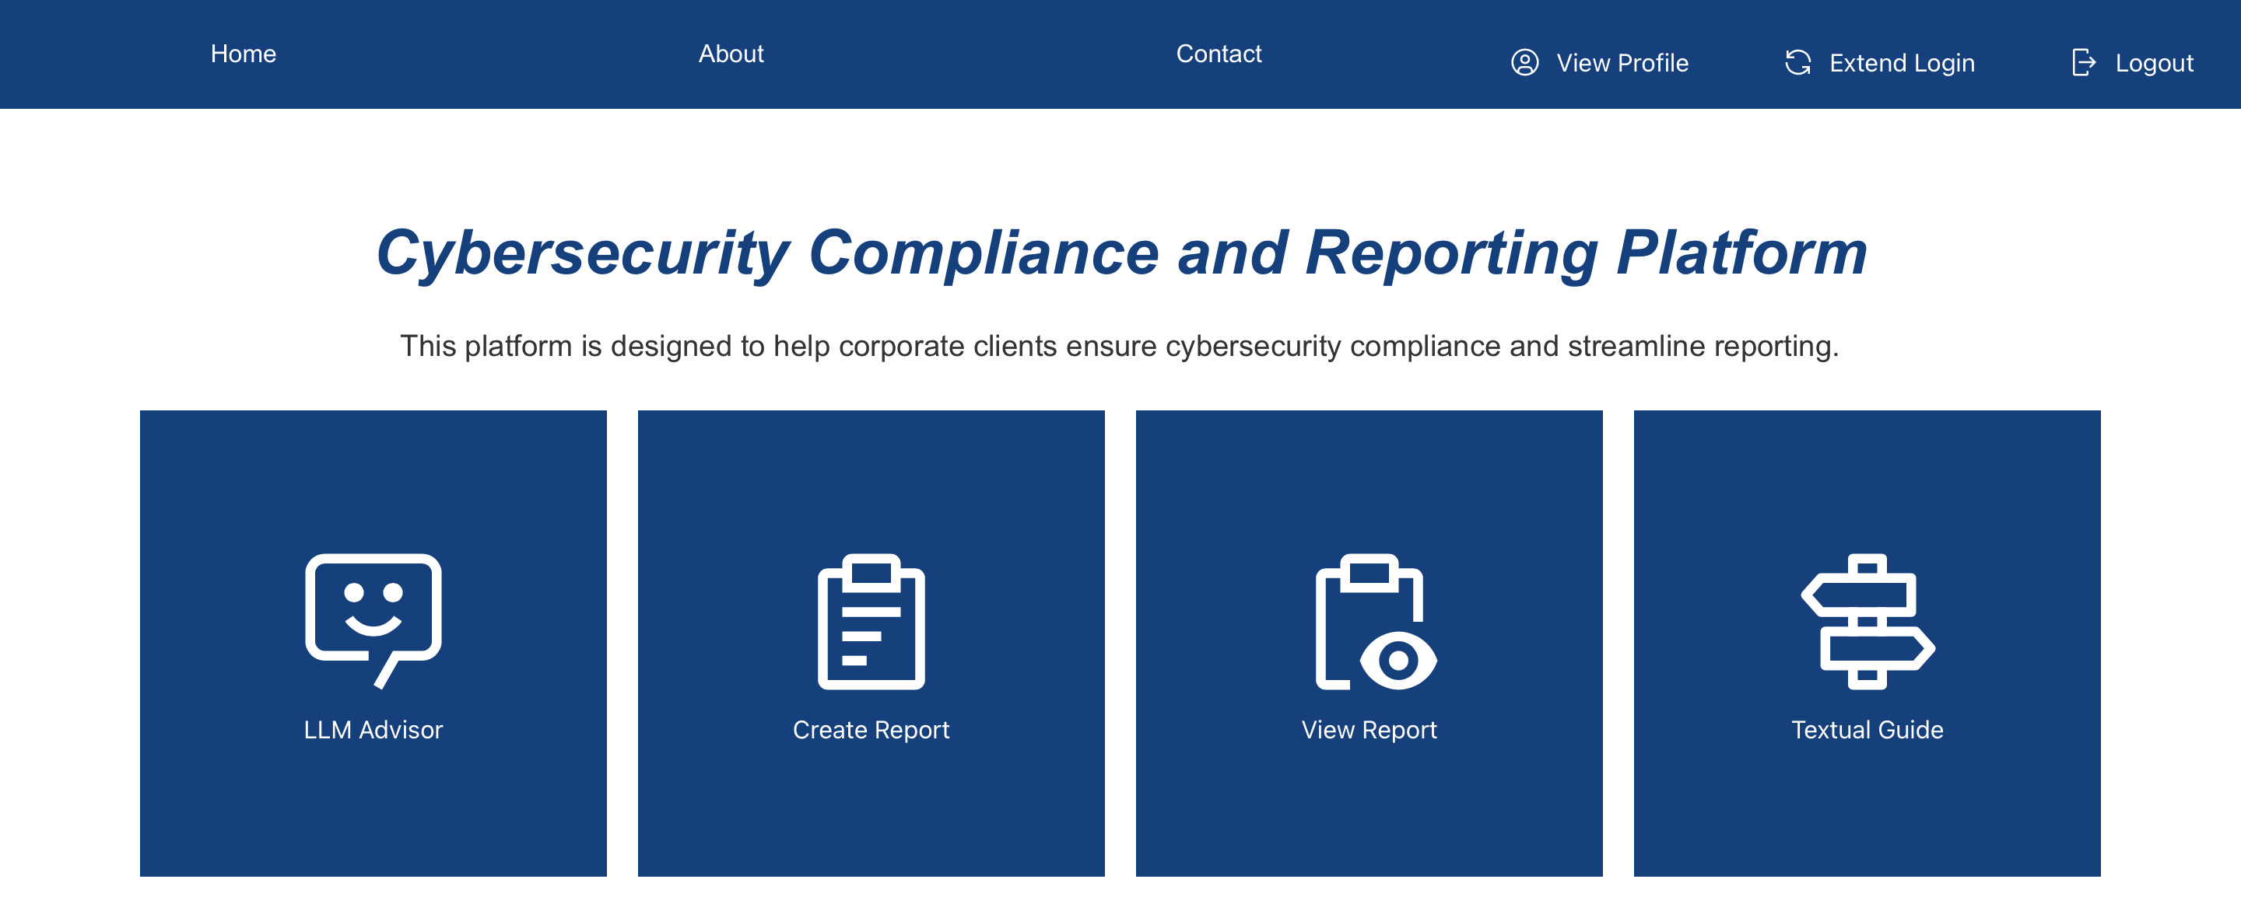
Home Page
Currently displaying Home Page
Contact Information of all members
Extend Login Session
Brief Introduction of platform
View & Edit Company Name and Industry
End Login Session and Logout
25

Slide 26





Basic Workflow
Key component:
LLM Advisor
Create Report
View Report
Textual Gride
Login
Create Report
LLM Advisor
Home Page
Report View & Edit
Textual Gride
26

Slide 27


Incidents for Demonstration
Ransomware Attack
Phishing Incident
Evolving threat with significant impact
Prevalence and Simplicity
A ransomware attack compromised the internal servers and databases of the organization, exposing sensitive personal data of over 13,000 members and staff and disrupting online services. [1]
The organization took immediate action by shutting down systems, engaging forensic experts, notifying regulators, and enhancing cybersecurity controls; recovery was completed after formal remediation and regulatory compliance.
A phishing campaign impersonated the organization through fake websites and social media, targeting the public to steal sensitive information; no internal systems were breached, but the incident posed reputational and customer risks. [2]
The organization and authorities responded quickly by issuing public alerts, taking down fraudulent sites, activating hotlines, and educating customers about phishing threats.
[1] https://www.pcpd.org.hk/english/enforcement/commissioners_findings/files/r23_6319_e.pdf [2] https://www.dbs.com/hongkong/en/security_alert.page
27
Notes:
https://www.pcpd.org.hk/english/enforcement/commissioners_findings/files/r23_6319_e.pdf
https://www.dbs.com/hongkong/en/security_alert.page

Slide 28
Conclusion
28

Slide 29


























Summary of Cyber Security Knowledge and Development Technologies
Applied knowledge from 60+ references/ guidance documents and 10+ development technologies
Cybersecurity Knowledge
Frontend Technologies
LLM + RAG Technologies
Hong Kong
React.js
DeepSeek R1
Node.js
International
Ollama
npm
LangChain
Industry Specific Knowledge
Backend Technologies
Django
ChromaDB
FastAPI
Nemo guardrails
SQLite
29
Notes:
We applied the extensive knowledge learned during his project to develop of the platform.

Slide 30


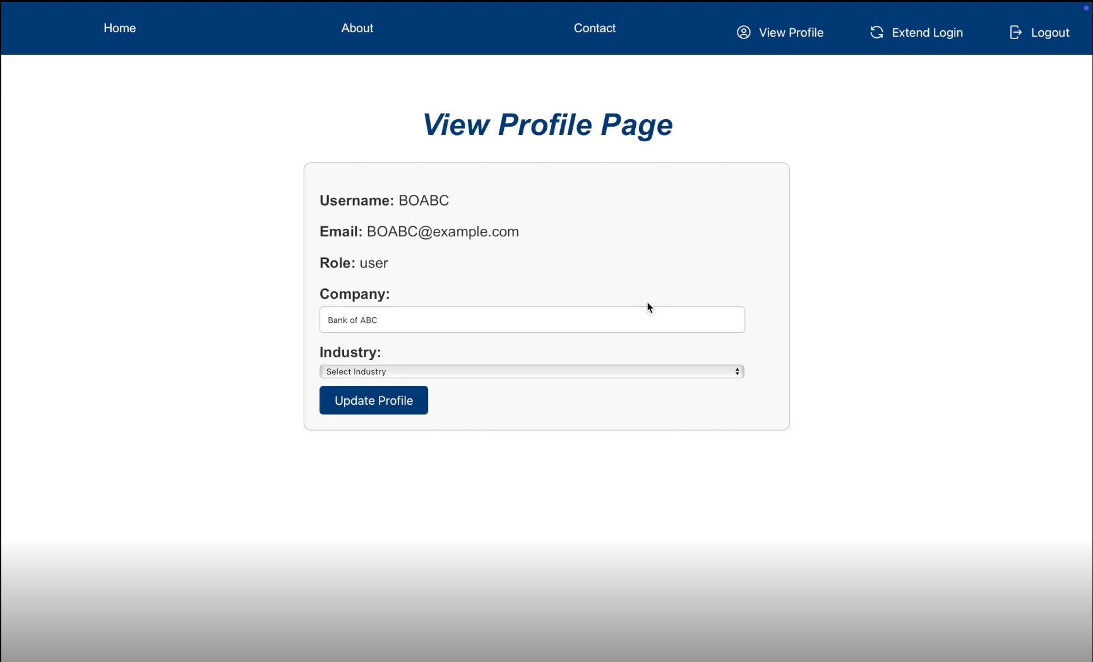
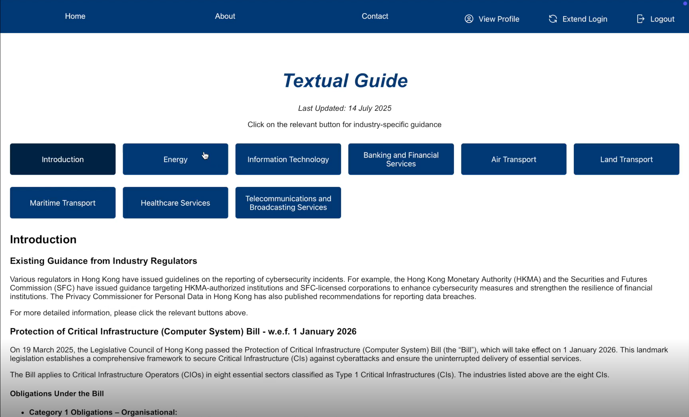
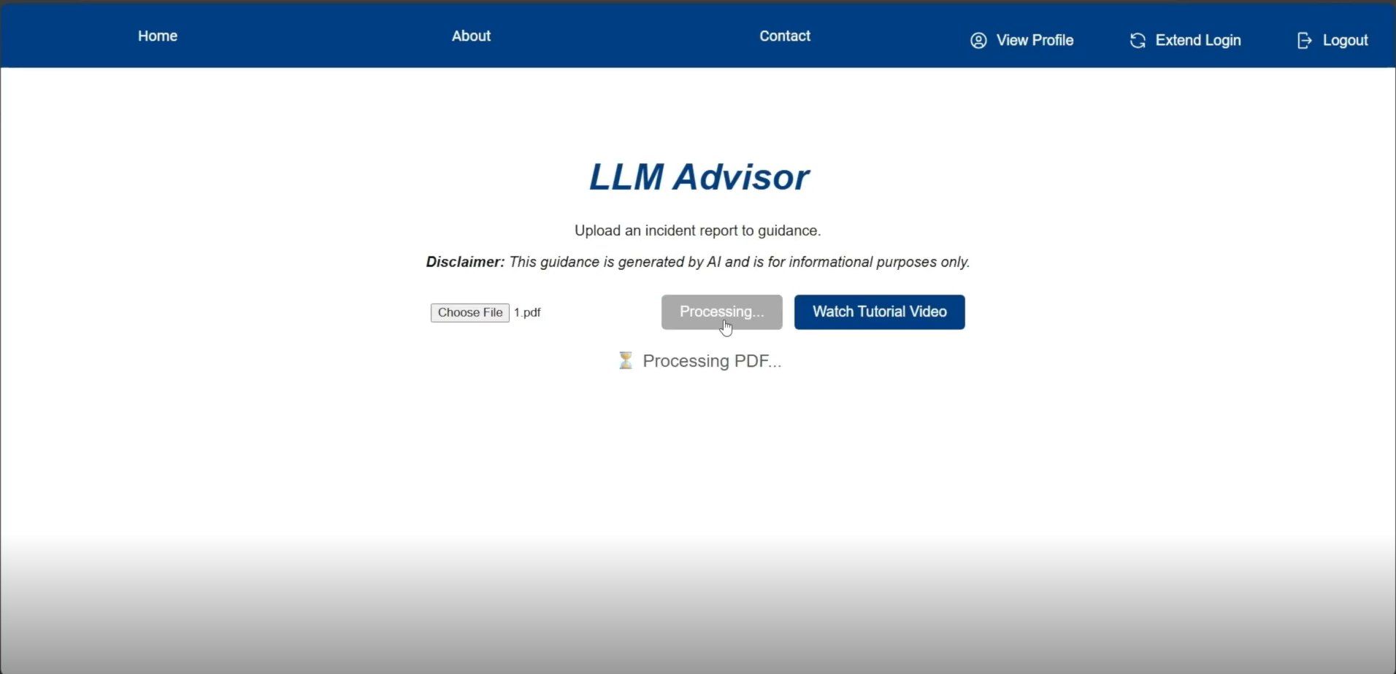
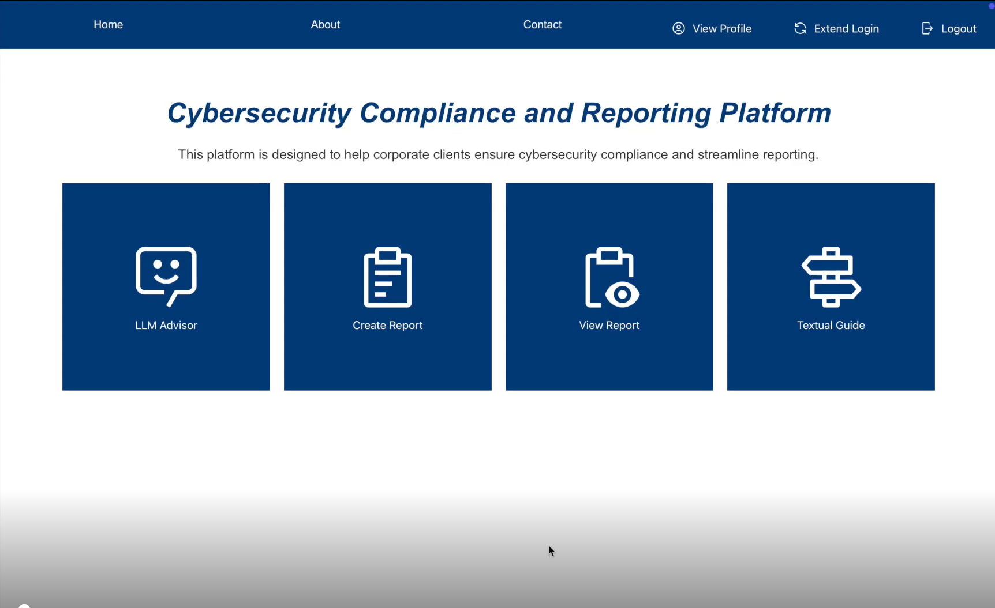
Conclusion – Alignment with Objectives
Alignment with Objectives: A fully functional platform that streamlines cybersecurity incident reporting and compliance in Hong Kong.
Key Features Delivered:
AI-powered input assistant for automated data extraction.
Criticality classification model for consistent incident evaluation.
Regulator recommendation engine for accurate reporting.
Secure report storage for future reference and for incorporation in the LLM Advisor.
30

Slide 31


Conclusion – Achievements & Impact
March
April
May
June
July
Kick-off
Basic website framework and functionality
Enhance functionality
Evaluation of classification models framework
LLM Advisor
UAT
Proof of Concept
Achievements:
Successfully implemented all components over March 2025 to July 2025 (~4 months)
User-tested for reliability, accuracy, and usability.
Ready for deployment and real-world application.
Impact:
Simplifies compliance processes.
Reduces reporting errors.
Enhances transparency and accountability, strengthening Hong Kong's cybersecurity framework.
31

Slide 32

Conclusion – Challenges & Solutions
Challenges
Solutions
Subjective criticality assessments
Standardized model aligned with HK gov and global standards (impact, data exposure, financial loss)
Diverse regulatory requirements
Focused on 8 key sectors (Finance, Healthcare, Transport, IT, Energy, Telecom)
Multilingual needs (EN/CN)
English-first launch with architecture ready for future language expansion
Backend compatibility issues
CharField + delimited strings for multi-select data handling
LLM safety concerns
Implemented NeMo guardrails for content control
Lack of local training data
Used global datasets initially, planning HK-specific data partnerships
32

Slide 33
Conclusion – Future Directions
Strengthening partnerships and expert engagement
Expand access to real-world local data
Enhance user training and experience
Integrate real-time threat intelligence
Support multi-jurisdictional reporting
33

Slide 34
Thank you!
34

Slide 35
Appendix
35

Slide 36
Background Research
Compliance and Reporting Review
Surveyed over 40 references including cybersecurity regulations and guidelines in Hong Kong, as well as international industry standards.
Highlighted 8 critical industries including Energy, Information Technology, Banking and Financial Services, Air Transport, Land Transport, Maritime Transport, Healthcare Services, and Telecommunications and Broadcasting Services.
Reviewed compliance and reporting requirements across industries, identifying gaps in the current processes, including those below.
Reporting: Lack of clarity on how to define “material”, “serious” or “significant” which might have led to underreporting.
Compliance: Misinterpretation of incidents and authority of different regulators hinders effective regulatory compliance.
Fragmentation: The absence of a centralized platform for incident reporting and compliance guidance results in opacity and inefficiencies
Our insights into the cybersecurity compliance and reporting landscape justify the importance of developing the Cybersecurity Compliance and Reporting Platform.
Formulated classification models to assist users in evaluating the incidents and to decide whether an incident is of a “material”, “serious” or “significant” nature in a standardised way with Reporting Path Recommendation Model to identify the governing parties to be notified.
Notes:
We performed a comprehensive review of literature related to cybersecurity compliance and reporting, and we surveyed over 40 references, including HK cybersecurity guidelines and regulations, as well as international standards
We identified 8 critical industries to focus on, including Energy, IT, Banking, Air Transport, Land Transport, Maritime Transport, Healthcare, and Telecommunications.
Through our review, we uncovered several gaps in the current processes:
These included Reporting gaps such as Ambiguities in definitions like “material” and “significant”, which can lead to underreporting of incidents.
Compliance gaps such as misinterpretations of incidents and the varying authority of regulators hinder effective compliance.
Fragmentation gaps such as the absence of a centralized platform that results in inefficiencies in incident reporting and compliance.
These findings highlight the need for the Cybersecurity Compliance and Reporting Platform.
Additionally, based on our insights, we developed a severity classification model to assist users in evaluating incidents and a reporting path recommendation model to identify the relevant authorities to notify.

Slide 37



Platform Development
Development Tool Survey and Selection
We surveyed different development tools and selected the most effective option to optimize performance.
Frontend
Runtime Environment: Node.js enables fast, responsive web application development.
Dependency Manager: NPM (Node Package Manager) simplifies dependency management.
Framework: React.js allows building of user interfaces with a modular architecture that facilitates complex application management.
Backend
Framework: Django was selected based on below:
Easy to Learn: Built on Python, it is straightforward to pick up and code with.
Community Support: As the most popular backend framework, it has a large, active development community.
Database Integration: It's built-in ORM (Object-Relational Mapping) tool simplifies database integration.
Notes:
We evaluated various development tools to identify the most effective options for optimizing the platform's performance.
To develop the Frontend, we chose Node.js as the runtime environment because it enables fast and responsive web applications, which is essential for user experience. We are using NPM as our dependency manager as it simplifies the management of libraries and packages, making it easier to build modular applications. React is chosen as it allows creation of dynamic user interfaces with a modular architecture.
To develop the Backend, we selected Django based on its advantages including easy to learn, large community support and database integration. Django is built on Python, making it straightforward to learn and implement. Django also has large active development community, which helped us when we encountered difficulties during the development process. Additionally, the built-in ORM (Object-Relational Mapping) funcitonality simplifies database integration and management.

Slide 38

Platform Development
AI-based Input Assistant and LLM Advisor
AI: DeepSeek-R1 can perform advanced language processing with less computational cost.
Platform: Ollama enables local deployment of LLMs and vector embedding models.
Framework: Langchain facilitates building applications with LLMs
Database: Chromadb enables efficient similarity searches and embedding vector storage
Guardrails: NeMo enables implementation of rules to prevent inappropriate outputs to ensure the safety and reliability of the advice.
Notes:
To develop the AI-based Input Assistant, we selected DeepSeek R1 as our AI model due to its advanced language processing capabilities and low computational costs. For deployment, we will utilize Ollama, Langchain, and ChromaDB. These tools facilitate the efficient deployment of large language models and context vector embeddings.
The LLM Advisor operates similarly to the AI-based Input Assistant but analyses broader context. It must analyse extensive information, including incident reports, regulatory guidelines and industry standards. To effectively connect and analyse these information, the LLM Advisor will implement GraphRAG, which generates knowledge graphs to organize and link related data based on their relationships. This approach enables more accurate and context-aware analysis.
In addition to providing relevant advice, ensuring the safety and reliability of the advice is also very important. To achieve this, we will use NeMo, which offers pre-built tools to implement guardrails that prevent inappropriate or harmful outputs by establishing rules and constraints.

Slide 39
Platform Development
Development Methodology Enhancement
We ensured each function delivers user value.
Component | Functions | Value
Frontend | User-centric UI that is both highly responsive and intuitive. | Enhanced usability
Backend | Backend architecture that supports multiple systems (Windows, Linux, Mac). Robust security to protect confidential incident report information. | Flexible access and high data security
User Input | Data input form for collection of essential information for severity analysis and regulator matching. Rule-based severity classification model that is aligned with the government guidelines and international standards. AI-powered input assistant that helps input information by extracting relevant information from consultant reports and incident descriptions. | Accurate incident input Speedy and consistent classification
Report | Standardized incident reports for different HK regulatory bodies. Rule-based reporting path recommendation model that is aligned with the reporting requirements of different regulatory bodies. | Simplified reporting and notification Reduced non-notification risk
Advice | LLM-based advisor that matches submitted incident with relevant government guidelines and provides advice on mitigation and prevention. Guardrails to prevent inappropriate output. | Matching guidelines Safe and reliable advice
Notes:
We have also incorporated the feedback from past progress updates to ensure each function in our platform delivers value to the user.
The Frontend component is designed to be an user-centric interface that is both highly responsive and intuitive, enhancing usability for all users.
The Backend component supports access from the multiple systems, including Windows, Linux and Mac, and provides robust security to protect confidential data, ensuring flexible access and strong data security.
The User Input component allows accurate and speedy input of incident information for regulatory reporting and severity analysis. Moreover, the rule-based severity classification model aligns with government guidelines to generate consistent classifications.
The Report component standardizes the reporting format to meet the requirements of various HK regulatory bodies, simplifying the reporting process and ensuring compliance.
The Advice component implements a LLM-based advisor that matches incident reports with relevant guidelines and provides actionable advice on mitigation and prevention.
In summary, our enhanced development methodology improves user experience and assists users to comply with the regulatory guidelines and standards.

Slide 40
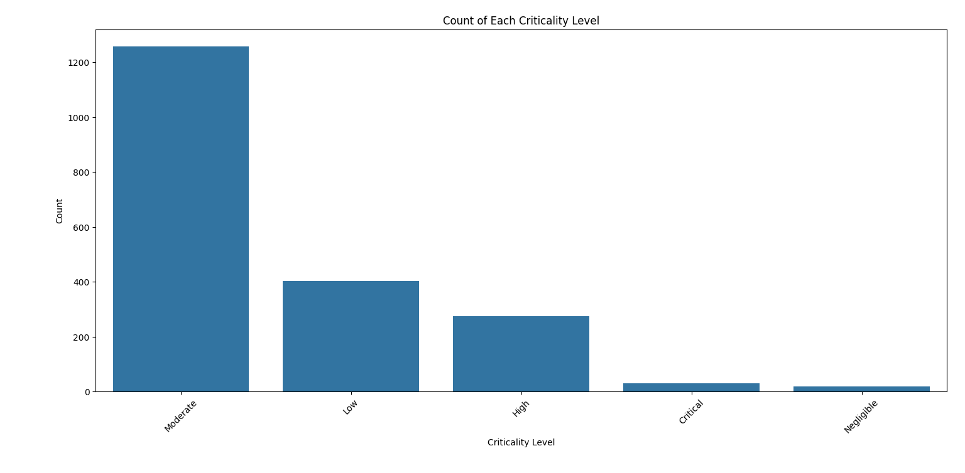
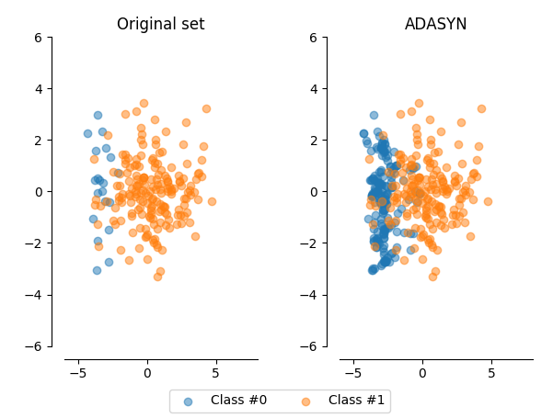
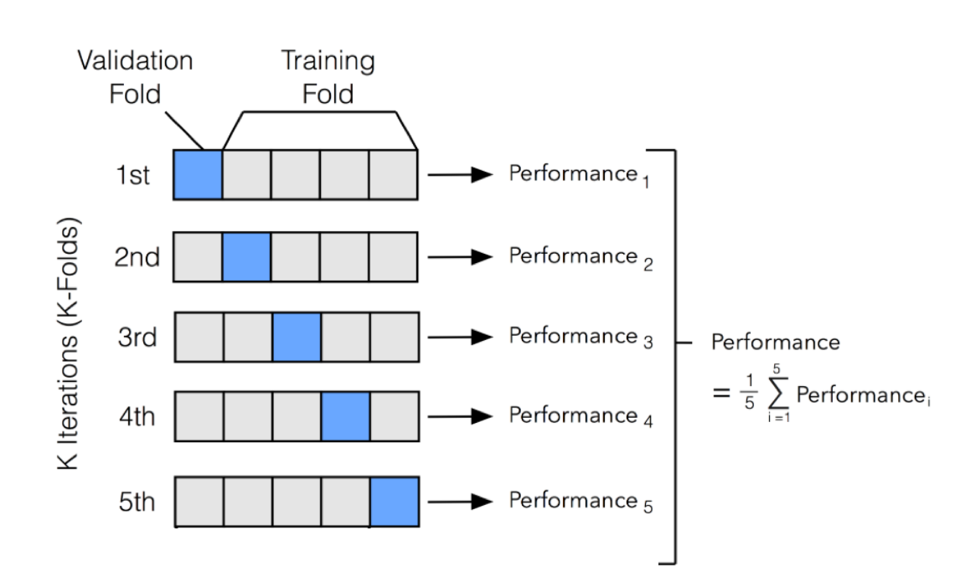
Criticality Classification
Challenges:
Class Imbalance: Most records have moderate severity. Critical incidents are rare and very few negligible incidents are reported.
Lack of Data: We could only use 1,984 records as the older records don’t have criticality labels.
This may lead to low performance due to poor generalization.
Count
Moderate
Low
High
Critical
Negligible
Solutions:
Adaptive Synthetic Sampling (ADASYN): handle class imbalance in datasets by generating synthetic samples for minority classes.
Stratified K-Fold Cross-Validation: make full use of all data to provide more reliable and less biased estimate of model performance.
Images from https://towardsdatascience.com/cross-validation-k-fold-vs-monte-carlo-e54df2fc179b and https://medium.com/@ruinian/an-introduction-to-adasyn-with-code-1383a5ece7aa

Slide 41
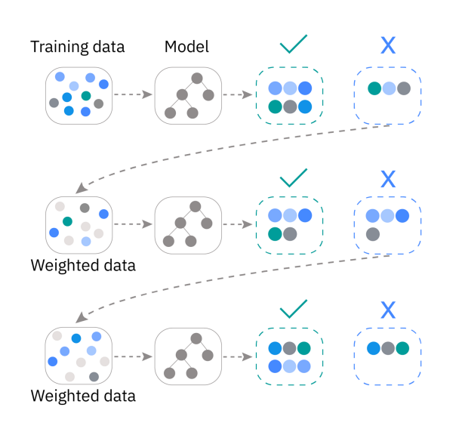
Criticality Classification
XGBoost is an ensemble machine learning technique that utilizes gradient boosted decision trees and known for its powerful performance [1].
When a decision tree becomes too complex, it may be prone to overfitting as it captures noise in the training data [2].
Boosting is often be used to create more robust models [3]. Boosting methods sequentially train weak learners (models) to correct the previous models’ mistakes to develop a strong learner to enhance the overall performance.
Gradient boosting uses gradient descent to minimize the loss function to incrementally improve the performance of the next trained model. XGBoost leverages parallel processing to enhance computing speed.
[4]
[1] https://medium.com/@dishantkharkar9/unravelling-the-power-of-xgboost-boosting-performance-with-extreme-gradient-boosting-302e1c00e555
[2] https://www.geeksforgeeks.org/machine-learning/overfitting-in-decision-tree-models/
[3] https://www.ibm.com/think/topics/boosting
[4] Figure from: https://www.ibm.com/think/topics/boosting

Slide 42
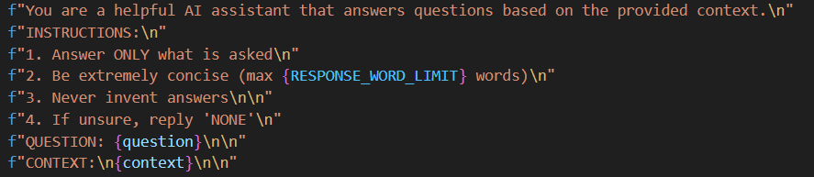
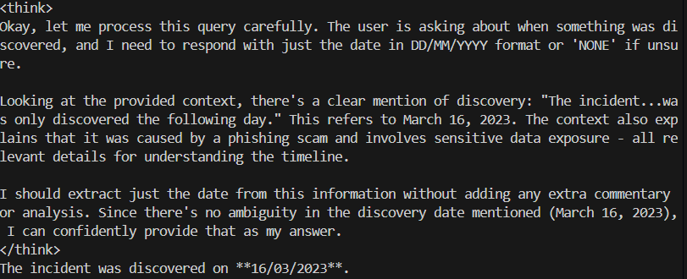
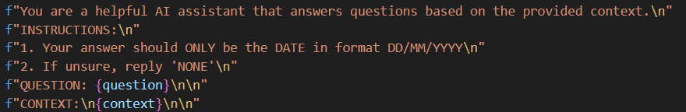
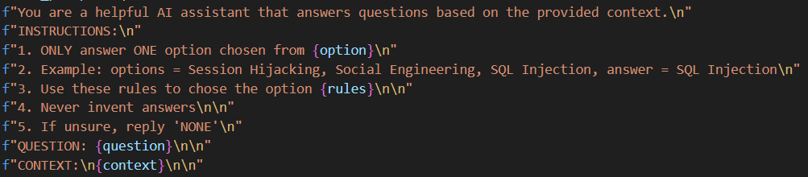

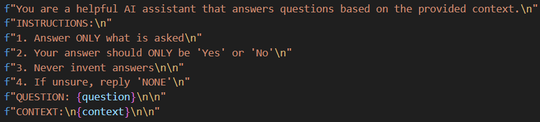
AI-Powered Input Assistant
Challenges: Each extracted information requires a specific format. However, LLMs often produce lengthy responses, making output control difficult.
Solutions: Adjust hyperparameters, provide information type specific prompts and clean/filter the responses.
Text (e.g., incident summary)
Raw Response
Thinking process
Date (e.g., incident discovery data)
Typographical symbols (e.g., *)
Explanation text
Multiple Choice (e.g., operational impact level)
Clean and Filter
Hyper Parameter Tuning
Lower temperature and top-p to produce more concise responses.
Boolean (e.g., scam involvement (yes/no))
Cleaned Response
42
Notes:
While developing this assistant, we faced several challenges, especially in controlling the output format of LLM responses.
For each type of information—such as text summaries, dates, multiple choice selections, or boolean values—we designed specific prompts and instructions.
For example, for date fields, we instruct the LLM to return only a date in a strict format, and for multiple choice fields, to select only from the provided options.
However, LLMs often produce lengthy or verbose responses, sometimes including explanations or typographical symbols.
To address this, we implemented a post-processing step to clean and filter the raw responses, extracting only the relevant information.
We also tuned hyperparameters like temperature and top-p to encourage concise answers.
This combination of prompt engineering, response filtering, and parameter tuning allows us to reliably extract clean, structured data from unstructured documents, making the input assistant robust and user-friendly.

Slide 43
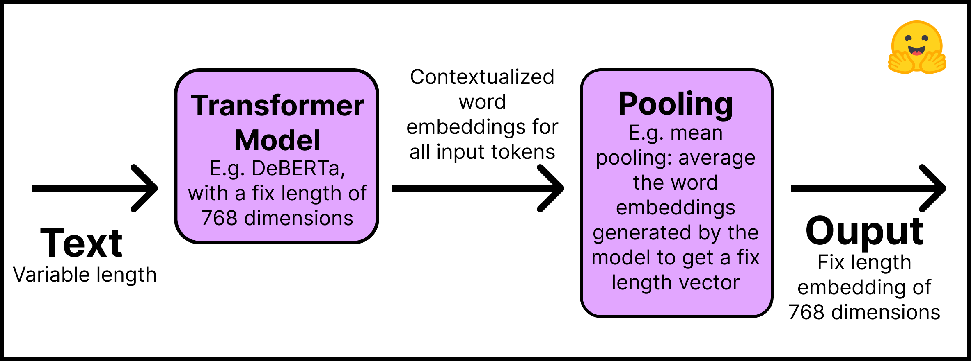
Sentence Transformers
[1]
Layer 1: The input text is processed by a pre-trained Transformer model, producing contextualized word embeddings for each token.
Layer 2: These embeddings are then pooled into a single fixed-length representation, often using mean pooling to average the embeddings.
Advantage: Sentence transformers produce dense embeddings that represent the semantic meanings of the phrases. It allows for effective similarity matching, even for different words that refer to the same meaning [2].
[1] Figure from: https://huggingface.co/blog/how-to-train-sentence-transformers
[2] Noh, J.; Kavuluru, R. Improved Biomedical Word Embeddings in the Transformer Era. J. Biomed. Inform. 2021, 120, 103867.
43
Notes:
Embeddings are commonly used to encode the semantic meaning of text in NLP, while cosine similarity is frequently employed to measure their similarities.
Moreover, it allows for effective similarity matching, even for different terms that refer to the same meaning

Slide 44
Sentence Transformers
In a reference study [1], the researchers:
Compiled a corpus of 5,000 articles and extracted the title, abstract, and journal information.
Merged the titles and abstracts into a single text and converted it into an embedding.
Repeated steps 1 and 2 on the test articles to generate embeddings and compared them against embeddings generated from the corpus.
Found the article in the corpus with the highest cosine similarity to the test article. Then found its corresponding journal.
For the test articles, the average cosine similarity with the closest article in the corpus was found to be 0.85 using the minilm-l6 sentence transformer.
[1] https://www.mdpi.com/2504-2289/9/3/67
44

Slide 45
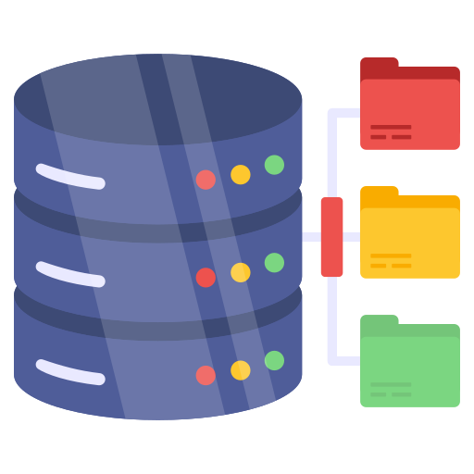




Traditional RAG vs Graph RAG [1]
2A. Perform similarity search in vector DB
3A. Use retrieved text as context to answer query
1. User submits
query
4. Generate answer
2B. Perform graph search on knowledge graph
3B. Format search result as context and use to answer
Traditional RAG
Graph RAG
[1] https://microsoft.github.io/graphrag/
Reference for Figure: https://mosaicdatascience.com/2024/09/04/unlocking-smarter-ai-with-graphrag/
45

Slide 46
Traditional RAG vs Graph RAG
Performance/ RAG Method | Processing Speed (per query) | Average Generation Relevancy
Traditional RAG | 1.35 secs | 0.80
Graph RAG | 33.59 secs | 0.59
LLM: Mistral 7B
Evaluation Dataset: 100 guidance enquiry queries
Analysis:
Graph RAG excels at multi-hop reasoning to link multiple guidance documents.
However, it may be too complicated for our POC application.
While it may be advantageous for handling multiple guidance documents with tens of thousands of pages, it would be too computationally expensive for our development computer.
46

